Slide 1





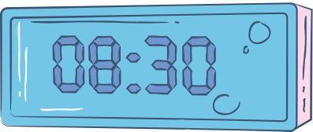
Presented by Bhoomika Sablani
COMPUTER
NETWORKS
Project Name: Bright Link School System
Multi-Building Campus Network

Slide 2



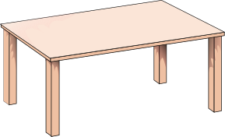
Problem
BrightLink School’s three buildings all use one mixed network. This causes slow performance, weak security, and no control over who accesses what.
The school needs a secure, organized, and manageable network.

Slide 3


Solution
To solve the problem, I will design a unified campus network using:
VLANs for Admin, Teachers, and Students
Router-on-a-stick to connect VLANs
DHCP Server for automated IP assignment
WPA2 Wi-Fi for student devices
ACLs (Access Control Lists) to block Student VLAN from reaching Admin VLAN

Slide 4



Objectives
✔ Efficient communication between buildings
✔ Secure separation of Admin, Teacher & Student traffic
✔ Automatic IP addressing through DHCP
✔ Safe Wi-Fi access for laptops
✔ Restricted access—Students cannot reach Admin network

Slide 5


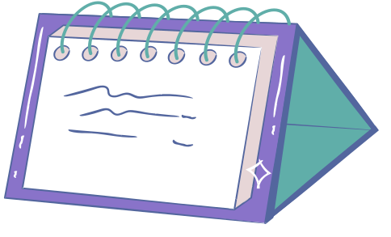

Importance
Secure: VLANs and ACLs stop students from reaching admin data.
Faster: Separate traffic reduces congestion.
Easy to manage: DHCP and centralized routing simplify control.
Better learning: Stable WPA2 Wi-Fi for students.

Slide 6

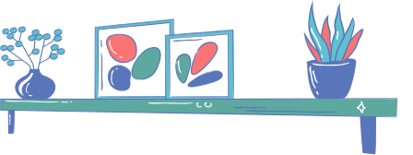
Thank You

